Slide 1

Title:
From Symptoms to Solutions: Bayesian Logistic and Linear Regression Models for Diabetes Prediction
Group Members:
Sheril Sarwar 238063
Sourav Sarker 237854
Technical University of Dortmund
30th January, 2025.

Slide 2
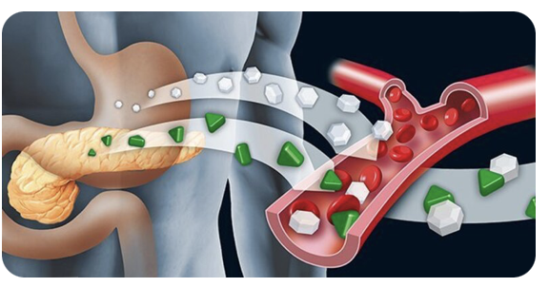
Introduction and Dataset Overview
1. This project aims to predict diabetes risk using Bayesian Logistic Regression for classification and Bayesian Linear Regression for continuous probability estimation, leveraging statistical insights for clinical decision-making. It focuses on analyzing key symptoms such as Polyuria, Polydipsia, and Age to identify significant predictors of diabetes.
2. The dataset consists of 520 observations and 17 features, including clinical symptoms (e.g., Polyuria, Polydipsia) and the diabetes classification (Positive or Negative).
Dataset Souce: https://www.kaggle.com/datasets/yasserhessein/early-stage-diabetes-risk-prediction-dataset/data

Slide 3

Research Goals and Analytical Approach
Our primary inquiry in this study focuses on understanding how clinical features influence diabetes risk. Specifically, we ask:
How do predictors such as Age, Polyuria, and Polydipsia affect diabetes diagnosis, and how can Bayesian Logistic and Linear Regression improve predictive performance and interpretability?

Slide 4
Objectives
Objective 1
To quantitatively assess the impact of individual predictors such as Age, Polyuria, and Polydipsia on diabetes diagnosis using Bayesian Logistic Regression.
Objective 3
To enhance the predictive accuracy and reliability of the model by incorporating Bayesian Inference for uncertainty quantification and prior knowledge integration.
Objective 4
To compare and validate model performance using cross-validation techniques (e.g., K-Fold) and statistical criteria like AIC and BIC for robust evaluation.
Objective 2
To explore relationships between predictors and the continuous probabilities of diabetes diagnosis using Bayesian Linear Regression.

Slide 5

Key Variables
Clinical Features:
Age: Significant predictor; risk increases with age.
Polyuria: Binary variable indicating excessive urination.
Polydipsia: Binary variable indicating excessive thirst.
Statistical Outputs:
Predicted Probability: Likelihood of diabetes from Bayesian Logistic Regression.
Class: Target variable (Positive/Negative) for diabetes diagnosis.
Evaluation Metrics:
Accuracy: Overall classification performance.
F1-Score: Balance between precision and recall.
Precision/Recall: Measures of true positives and sensitivity.

Slide 6
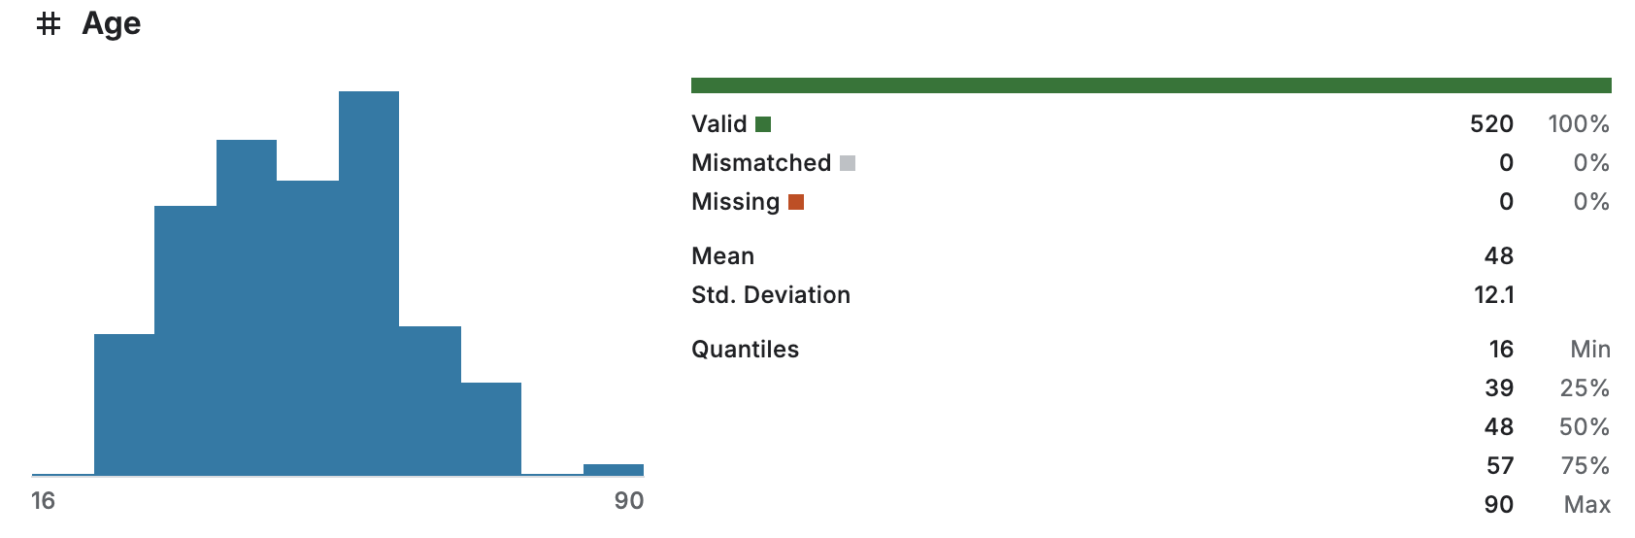
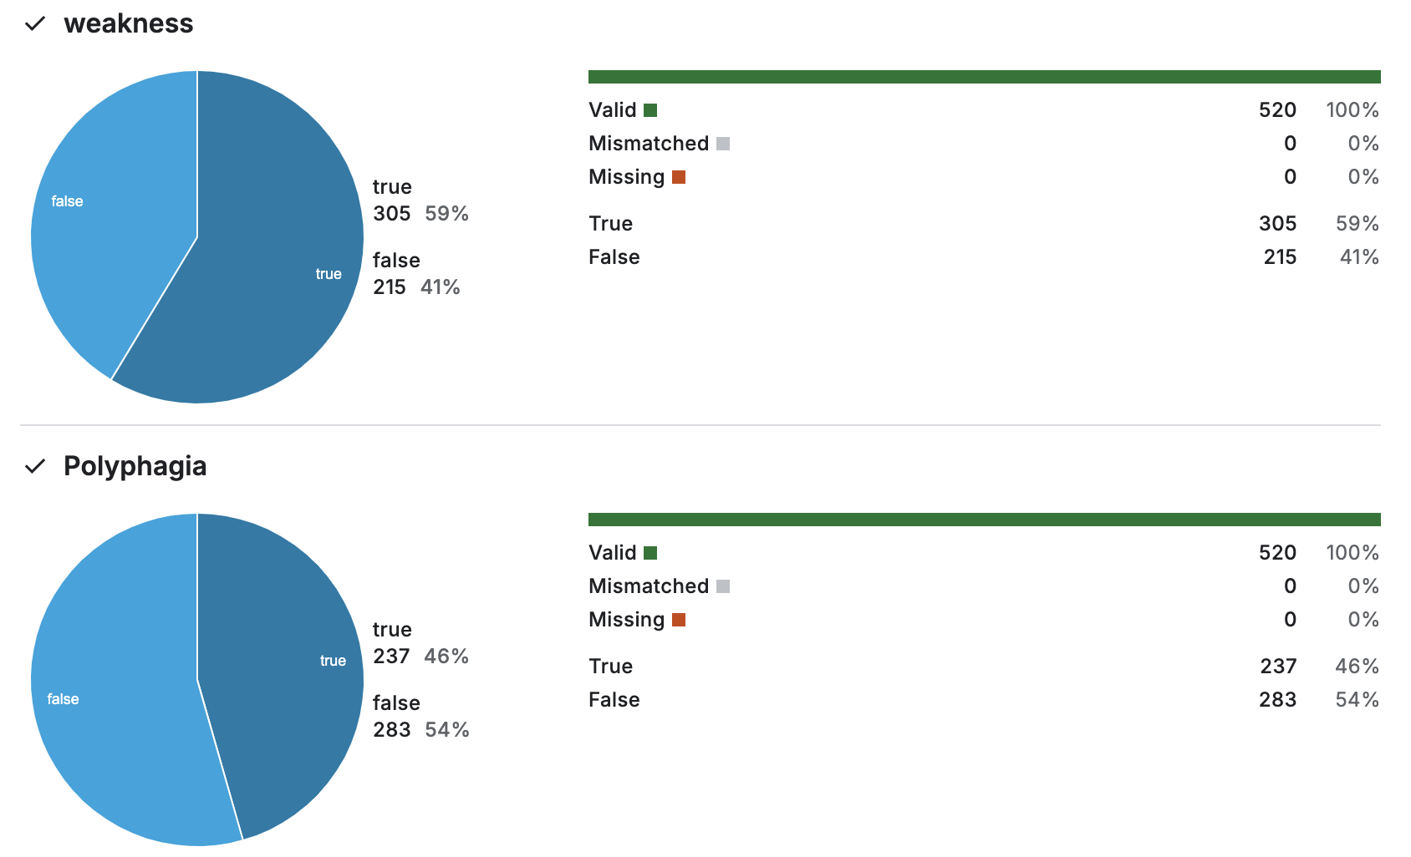
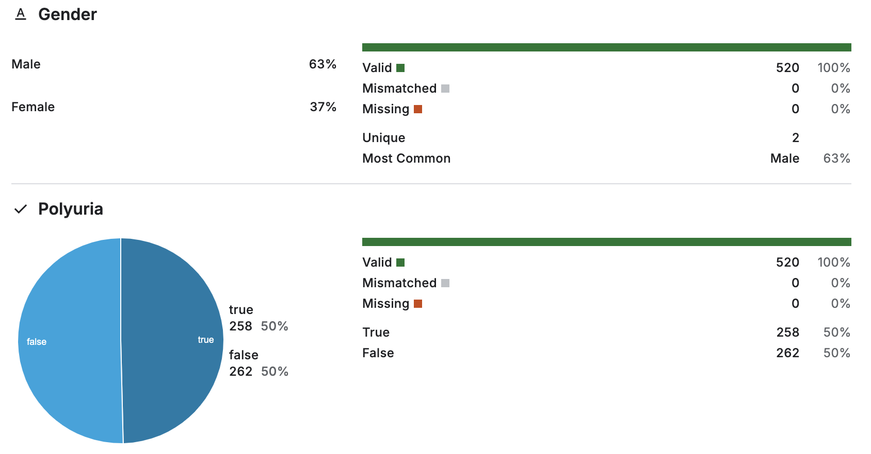
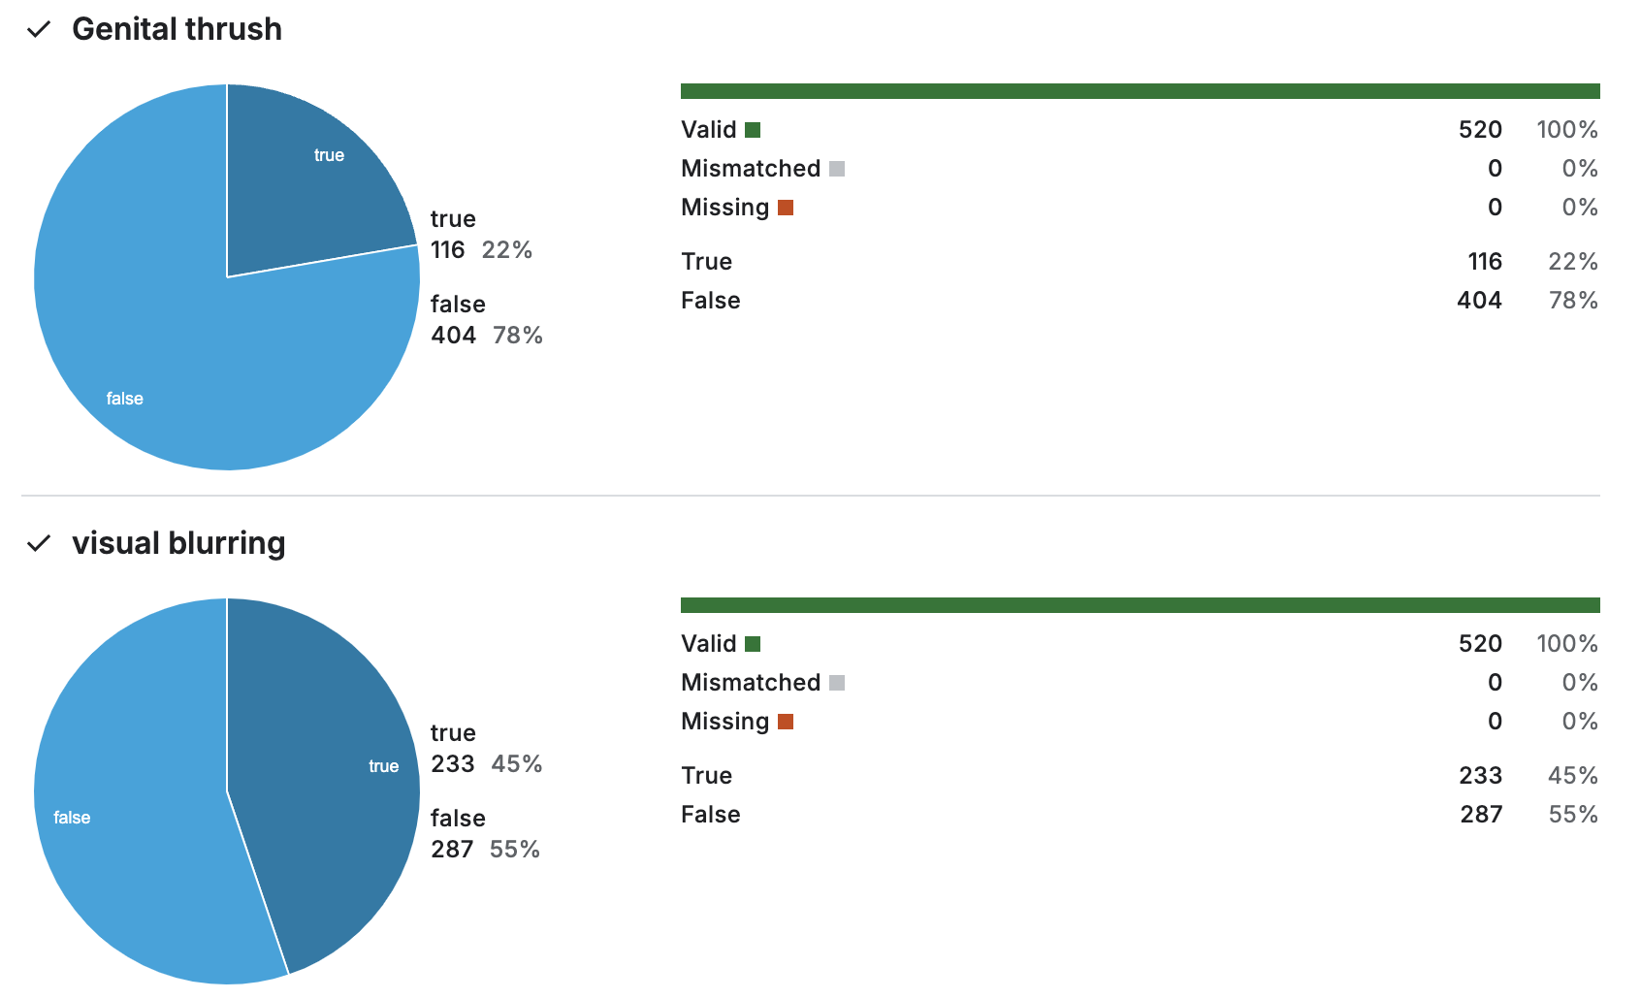
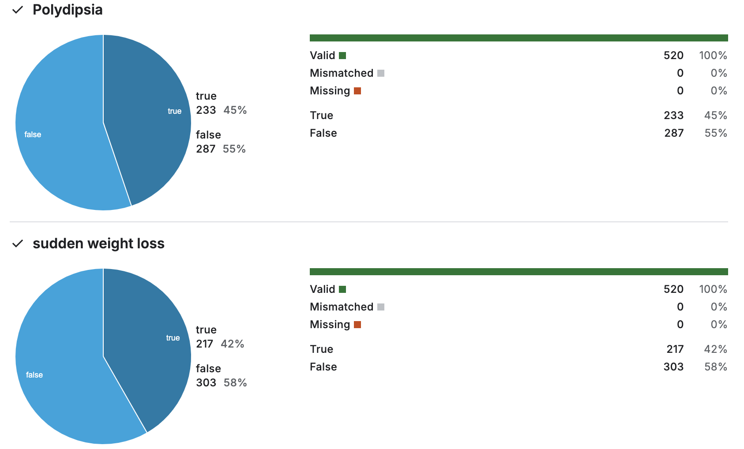
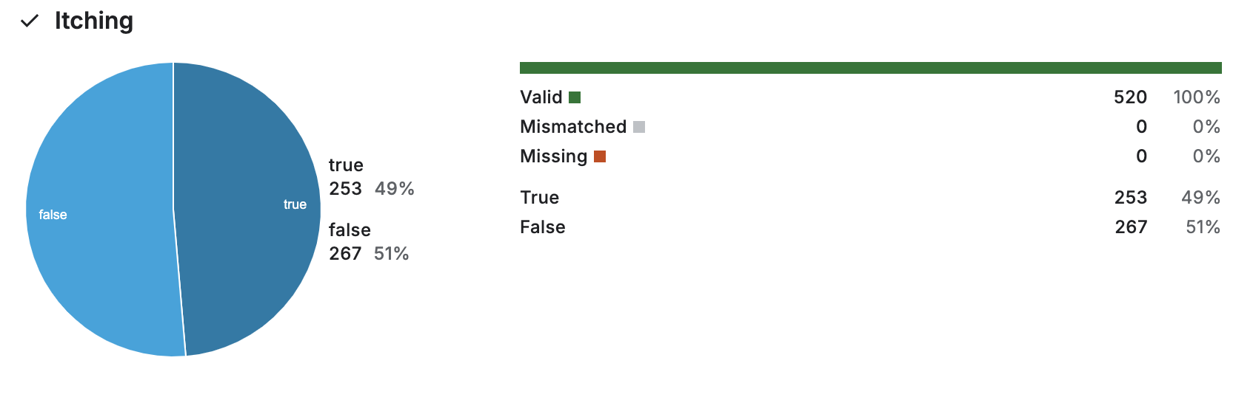
The key insights of the dataset

Slide 7
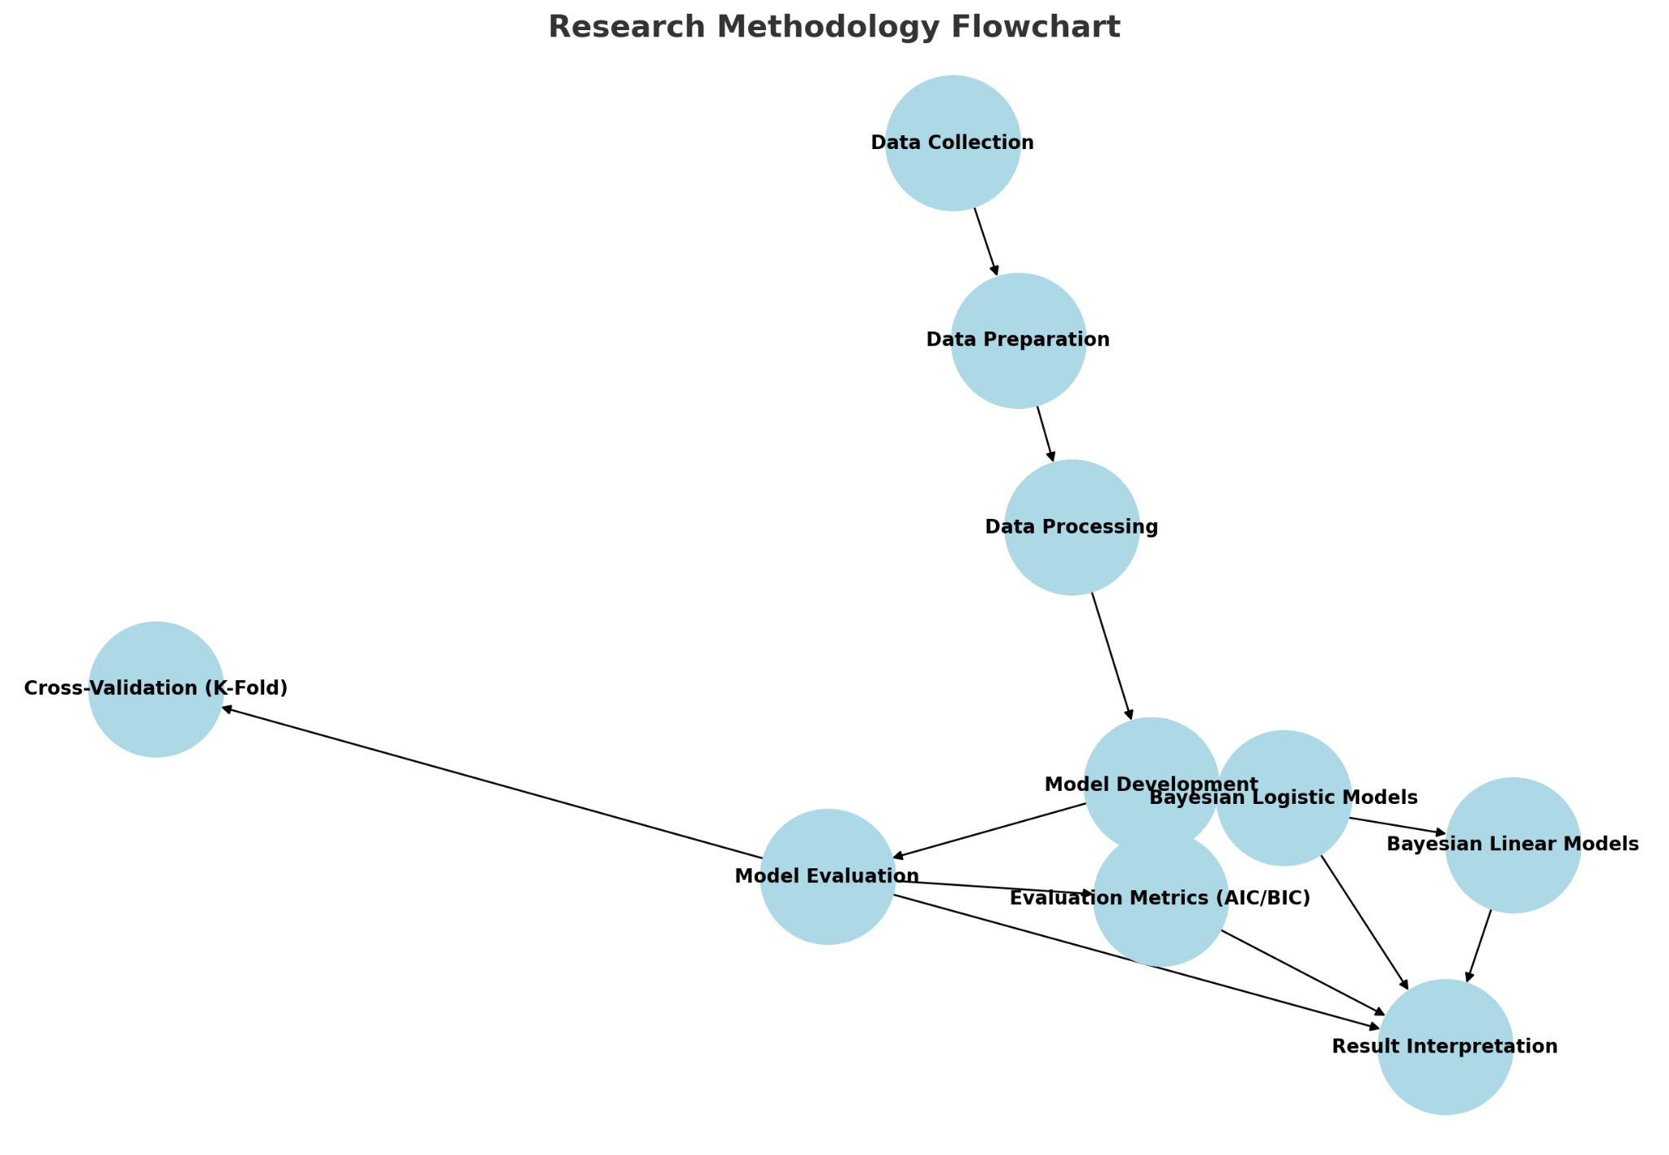

Slide 8
Data Preprocessing
• Converted categorical variables (e.g., Polyuria, Polydipsia) to binary numeric values.
• Removed samples with missing values.
• Ensured balanced train-test split for reliable evaluation.

Slide 9
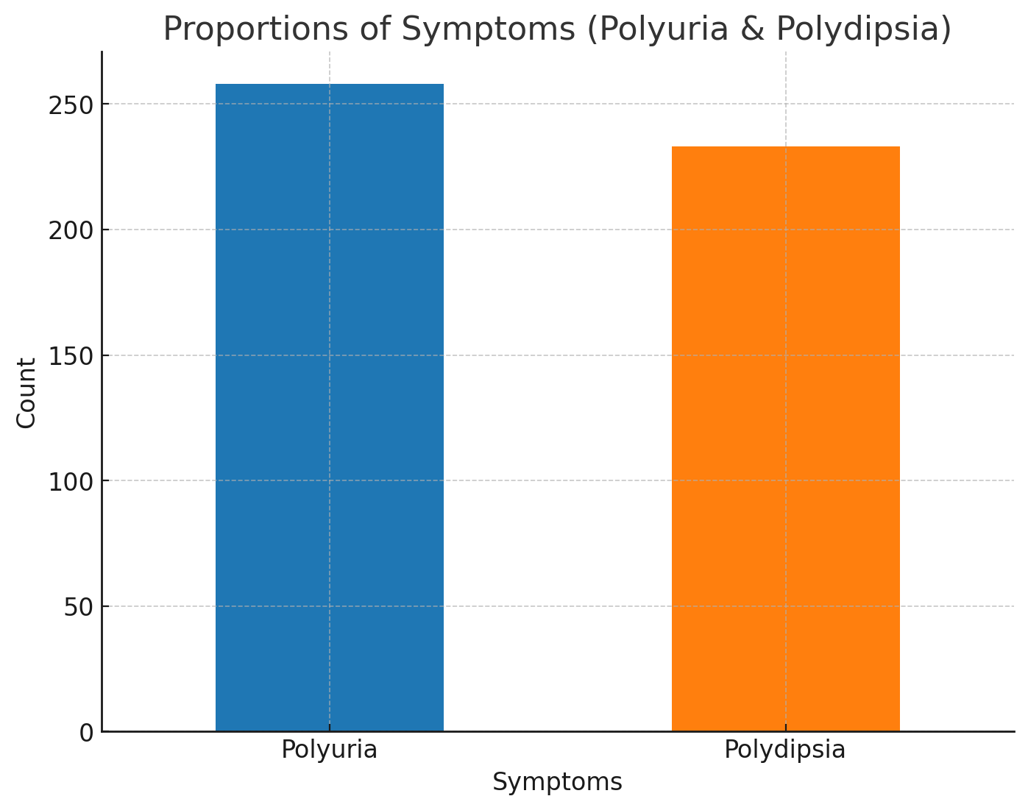
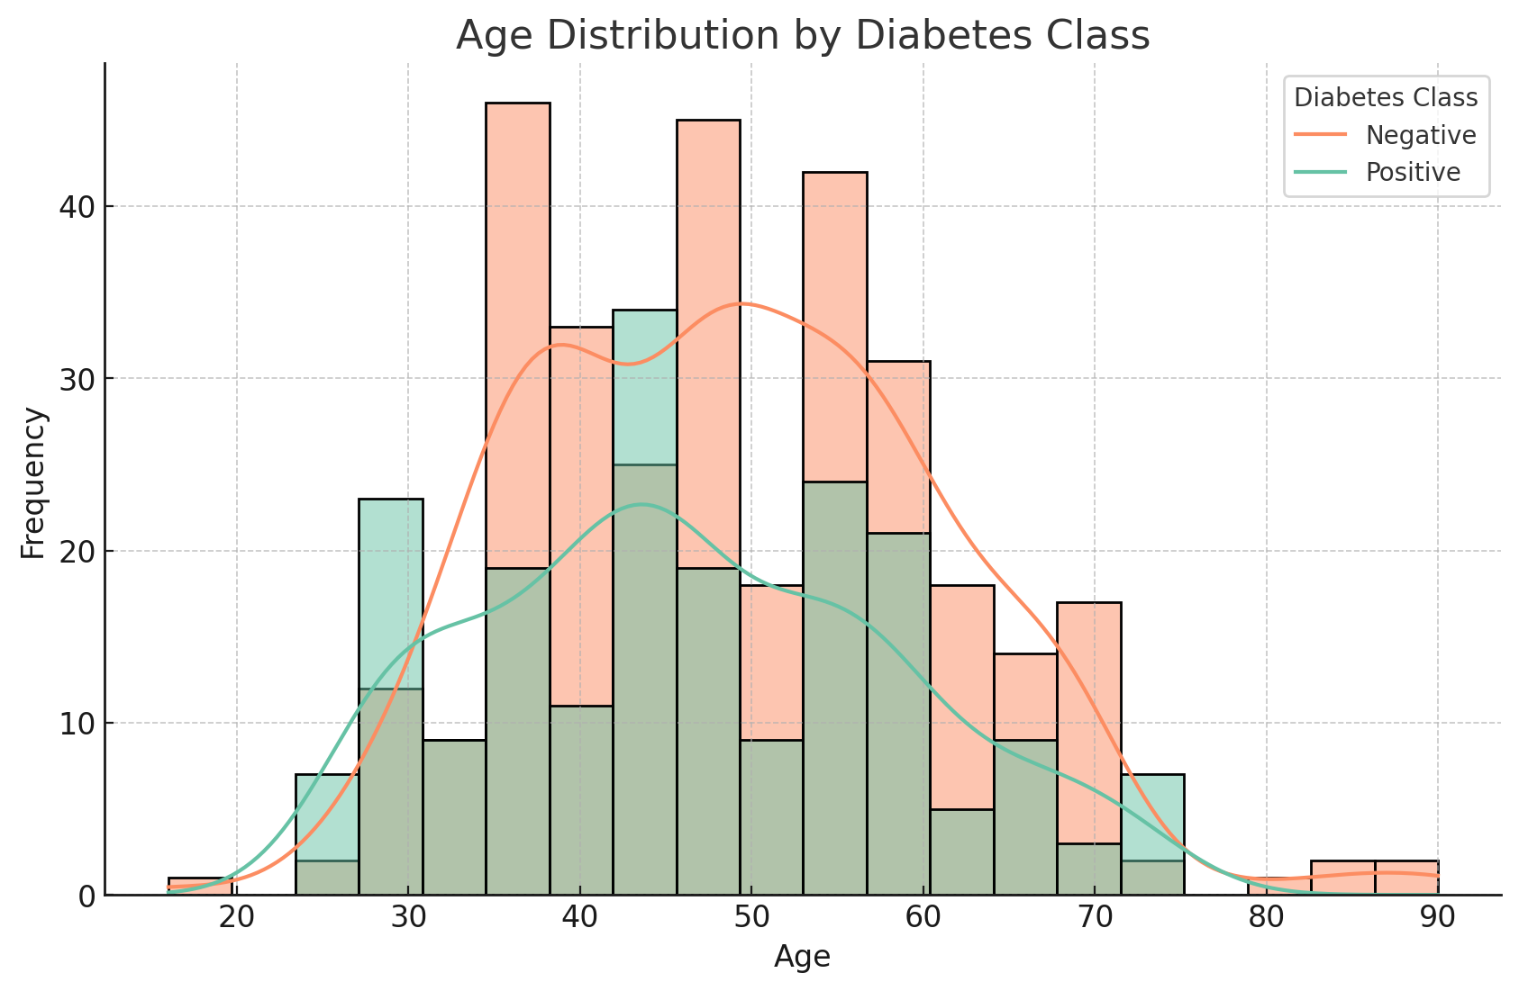
Visualization

Slide 10
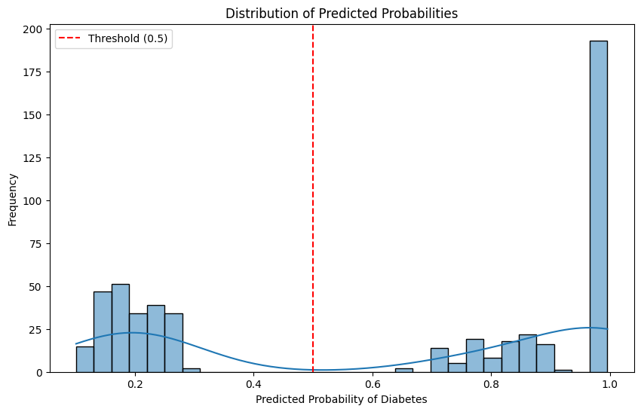

Slide 11
Model Descriptions
Bayesian Logistic Regression
Bayesian Logistic Regression is used to classify individuals as diabetes-positive or negative based on predictors such as Age, Polyuria, and Polydipsia. This model estimates the probability of diabetes while incorporating prior knowledge to enhance prediction accuracy and handle uncertainty. It provides interpretable coefficients to quantify the impact of each predictor on the likelihood of diabetes. Evaluation metrics such as Accuracy, Precision, Recall, and the F1-Score ensure the model's effectiveness.
Bayesian Linear Regression
Bayesian Linear Regression predicts continuous probabilities of diabetes using outputs from the logistic regression model. It models the linear relationship between predictors (e.g., Age, Polyuria) and diabetes probabilities while quantifying uncertainty in predictions. This makes it particularly useful for robust and reliable decision-making. The model’s performance is assessed using Mean Squared Error (MSE) and R-Squared, ensuring a strong fit and accurate predictions.

Slide 12

PORTFOLIO
#
Optimization Output(Bayesian Logistic Regression)
Optimization successfully terminated after 8 iterations.
Final log-likelihood value: 0.319358.
Model converged with statistically significant predictors.

Slide 13
Coefficients Interpretation
Logistic Regression Accuracy
Age: Negative coefficient, slight decrease in diabetes probability with age.
Polyuria: Strong positive coefficient, increases diabetes odds by ~21.6x.
Polydipsia: Strong positive coefficient, increases diabetes odds by ~28.5x.
Accuracy: 87%
Bayesian Logistic Regression effectively classifies diabetes based on predictors.

Slide 14
Linear Regression Results
Mean Squared Error (MSE): 0.01
R-squared: 0.91
Model predictions closely align with actual values.

Slide 15
Hyperparameter Tuning
Cross-Validation
Grid Search used to optimize hyperparameters (C, solver).
Best parameters: {'C': 0.1, 'solver': 'liblinear'}
Regularization improved generalization.
K-Fold Cross-Validation (5 splits) assessed model performance.
Ensured robust evaluation across different data subsets.

Slide 16
Evaluation Metrics
Confusion Matrix
Accuracy: 87%
Precision: 92%
Recall: 86%
F1 Score: 89%
True Positives: 57
False Positives: 7
True Negatives: 33
False Negatives: 7

Slide 17
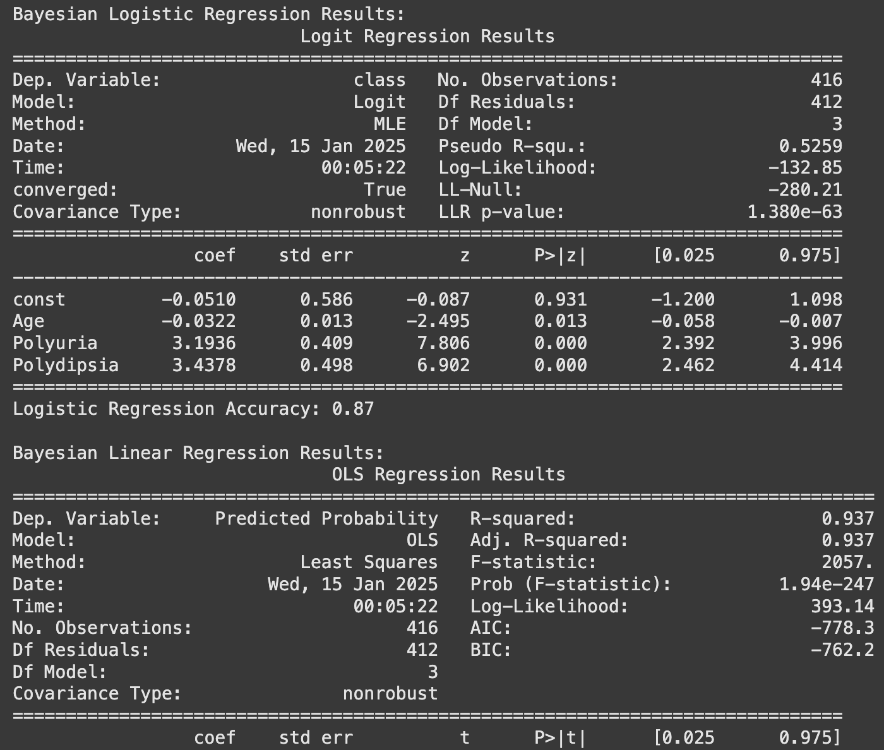
Model Comparison
Bayesian Logistic Regression:
Accuracy: 87%
Strengths: Predicts binary outcomes and provides uncertainty quantification.
Key predictors: Age (-0.032), Polyuria (+3.19), Polydipsia (+3.44).
Bayesian Linear Regression:
Mean Squared Error (MSE): 0.01
R-squared: 0.91
Strengths: Explains variance in probabilities and complements logistic regression.
Predictors: Age, Polyuria, Polydipsia.

Slide 18

Strengths
Accurate and interpretable predictions.
Robust evaluation with Bayesian inference.
Limitations
Sensitive to prior assumptions.
Computationally intensive for large datasets.

Slide 19


Practical Applications
Early Detection of Diabetes: The models can identify individuals at high risk of diabetes based on symptoms like Polyuria and Polydipsia, enabling early diagnosis and timely medical intervention. This helps reduce the progression of diabetes-related complications.
Clinical Decision Support: The probabilistic predictions from Bayesian models provide clinicians with interpretable insights, allowing them to make informed decisions about further diagnostic testing or preventive treatments.
Personalized Risk Assessment: By incorporating patient-specific data, the models can generate personalized diabetes risk profiles. This empowers healthcare providers to tailor treatment plans and prioritize high-risk individuals.
Integration with Healthcare Systems: These models can be integrated into electronic health record (EHR) systems to provide real-time risk predictions for diabetes during routine patient check-ups.

Slide 20

Take-Home Messages Project Link and QR code
The analysis highlights key predictors of diabetes, with "Polyuria" and "Polydipsia" identified as the most significant symptoms, increasing the likelihood of diagnosis by over 20-fold. Logistic regression demonstrated strong performance, explaining 51.8% of the variance in diabetes risk (pseudo R² = 0.5183) and achieving an average cross-validated accuracy of 87%. Additionally, linear regression confirmed the reliability of the predicted probabilities, with an R² of 0.91. These findings emphasize the importance of symptom-based risk assessment for early detection and intervention.
Project Link: https://www.kaggle.com/code/srvskr3245/from-symptoms-to-solutions-bayesian-logistic-and
Email: sarwar.sheril@tu-dortmund.de
sourav.sarker@tu-dortmund.de

